Slide 1
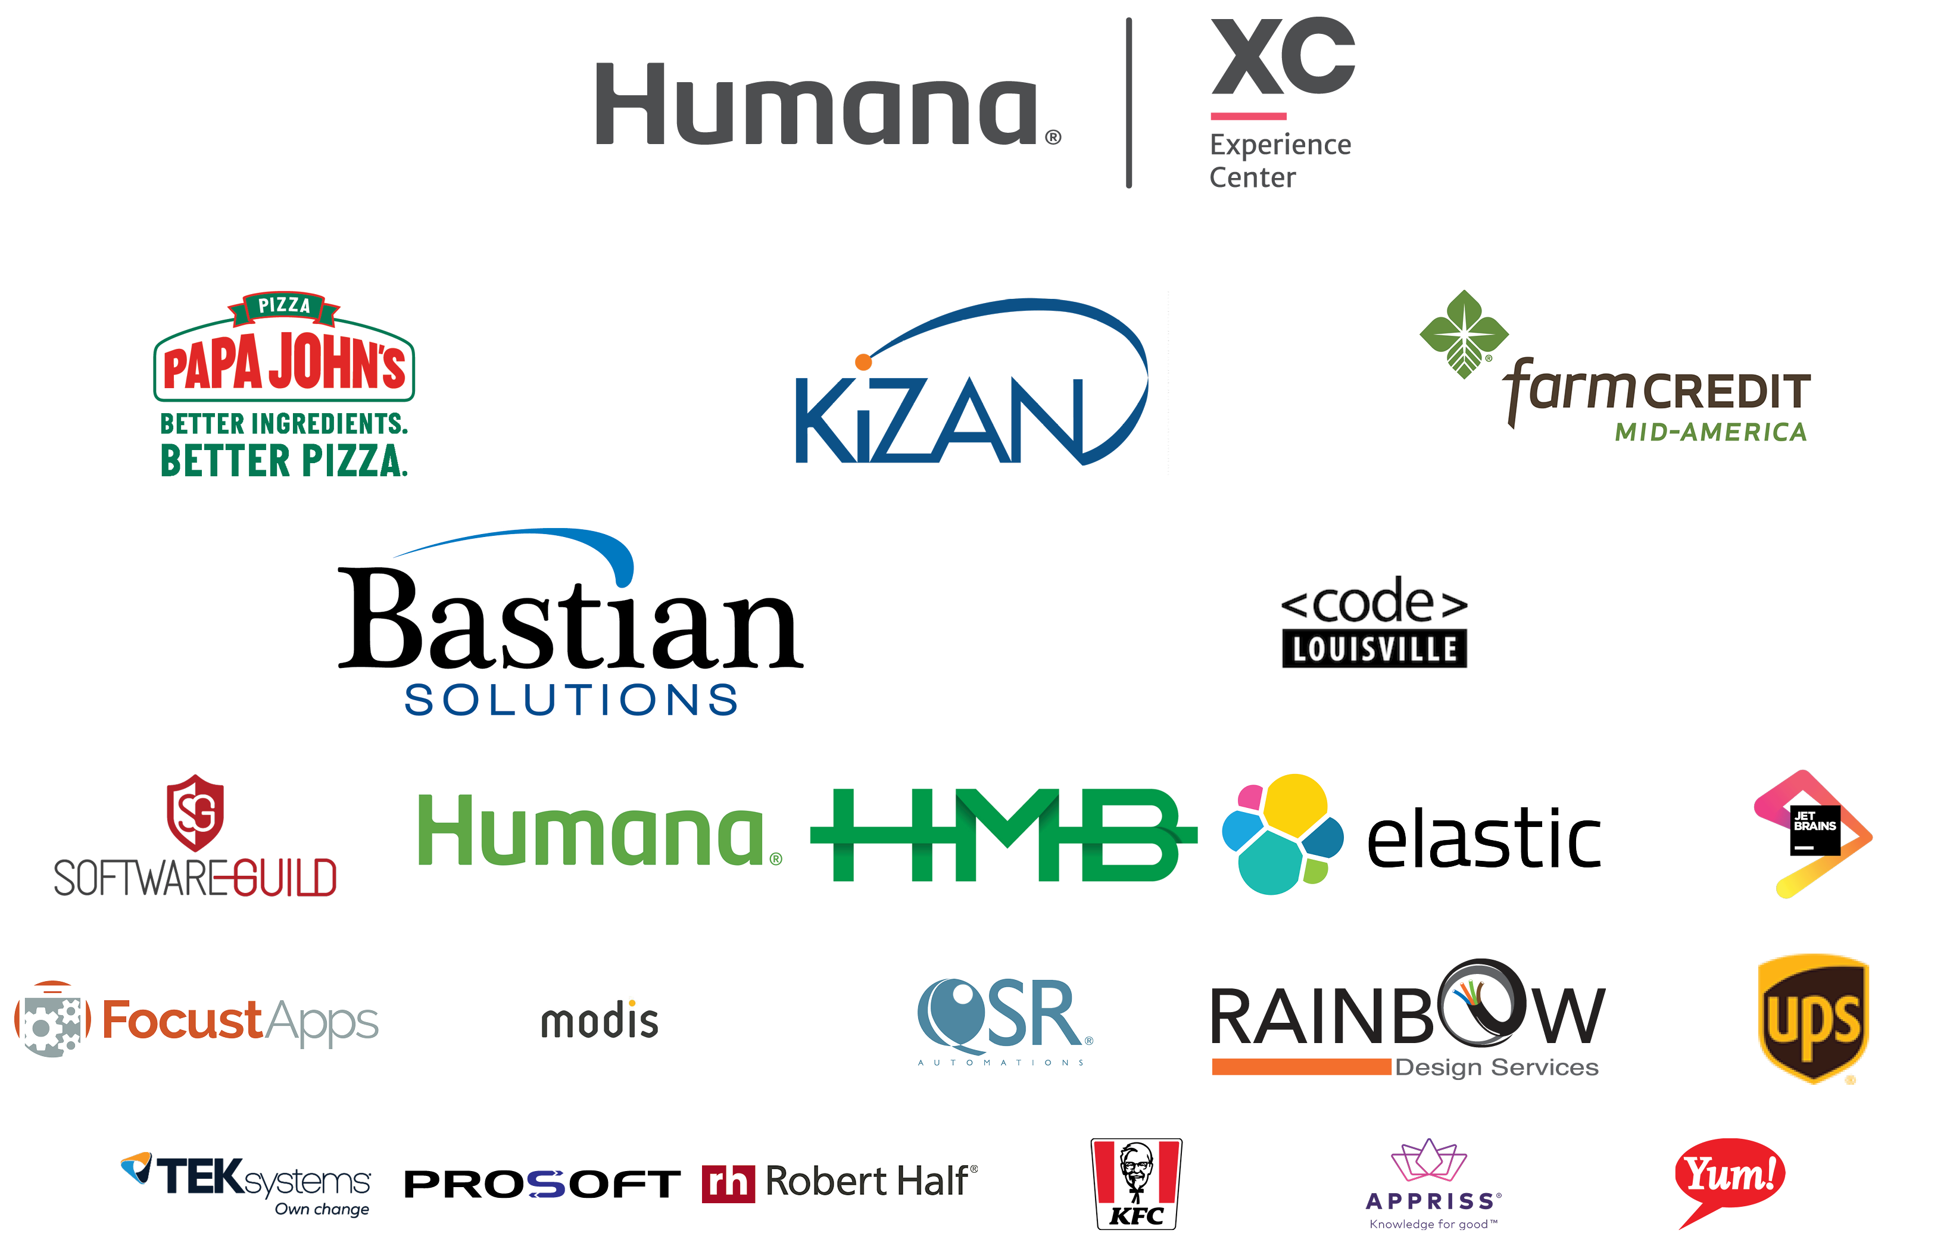
Code PaLOUsa 2021 Sponsors
Notes:
Sponsors include:
Humana XC Experience Center
Papa Johns
Kizan
Farm Credit Mid-America
Bastian Solutions
Code Louisville
Software Guild
Humana
HMB
elastic
JetBrains
Focust Apps
Modis
QSR Automations
Rainbow Design Services
UPS
TekSystems
Prosoft
Robert Half
KFC
Appriss
Yum!

Slide 2

Introduction to Accessibility

Slide 3
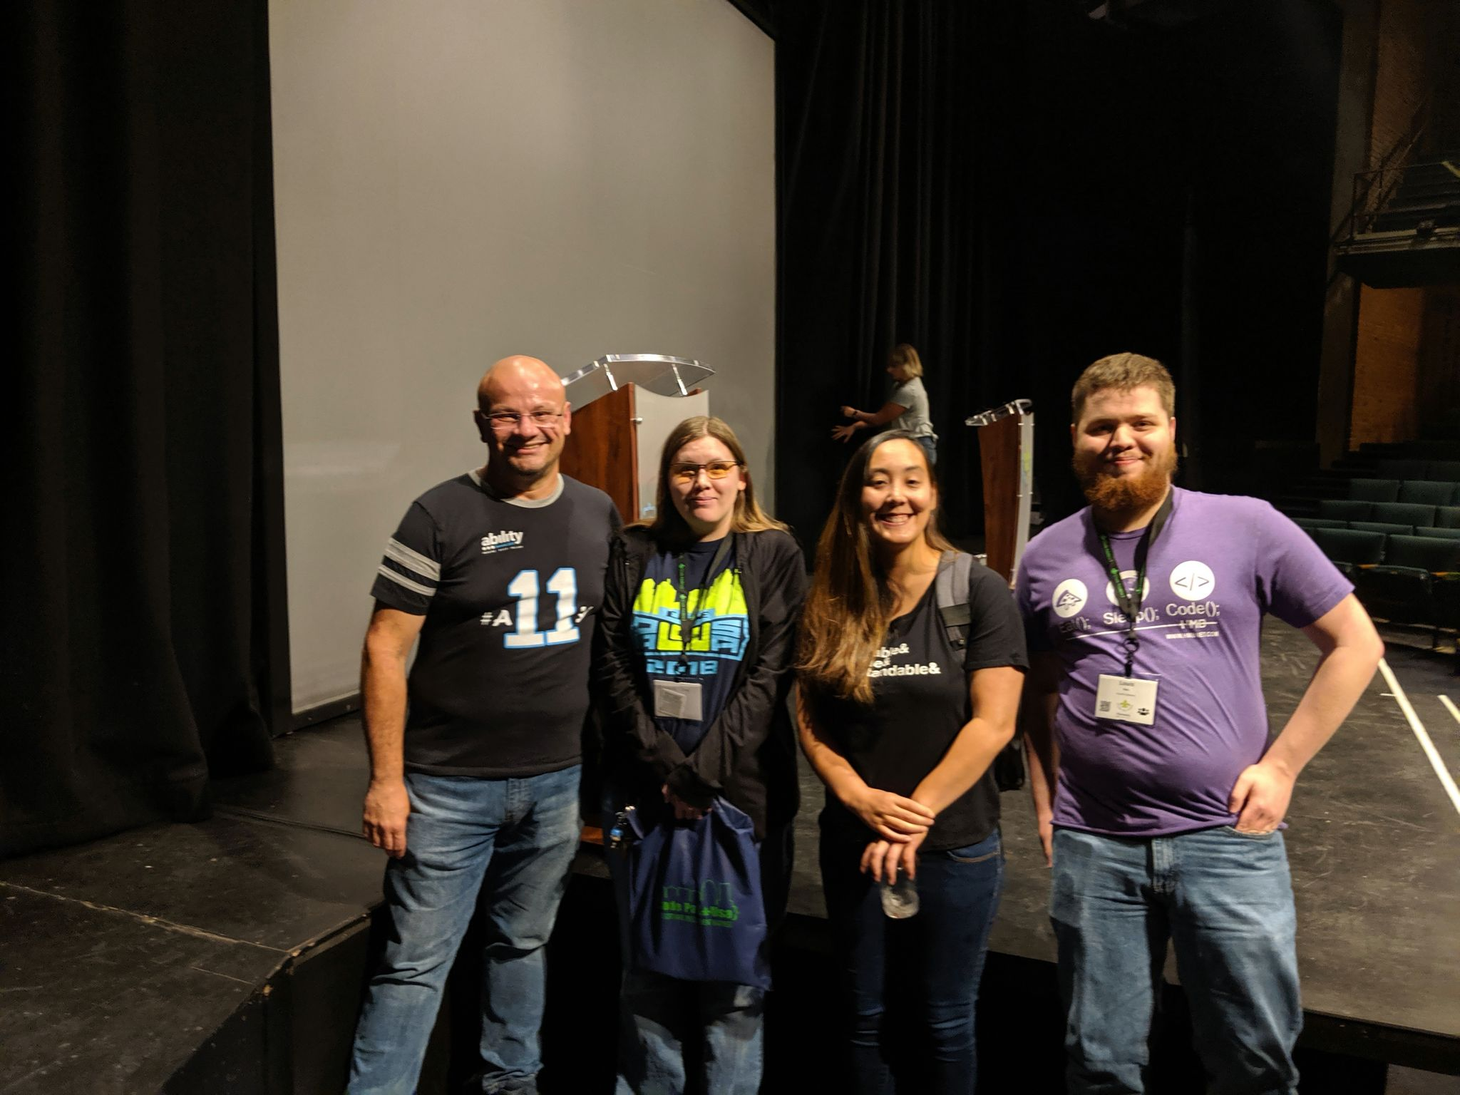
Who Am I?
Notes:
Elizabeth, Beth, Liz, or whatever… really I don’t care.
Graduated from WKU with a BA in Sociology and a minor in Criminology (because I am a huge Tru Crime fan on top of being a techie and a gamer).
Graduate of the Code Louisville, a non-profit, programming bootcamp.
I also love traveling. I’ve been to Japan twice, once as a student for 4 months, and once as a tourist for a month. I have also been to Amsterdam.
I have spoken at numerous conferences and tech meetups on topics relating to Accessibility. The picture on this slide is from Code PaLOUsa 2019 when I last presented for a conference. Pictured from left to right is:
Gianujo Rabellino, Director of Accessibility and Inner Source for the Cloud+AI Division at Microsoft
Me
Sarah Higley, Microsoft Software Development Engineer and Accessibility Advocate
Louise Ries, former Software Development Engineer at CloudFit Software
Accessibility is a passion for me that I plan to make an increasing part of my career going forward.

Slide 4

DHS Trusted Tester
The Trusted Tester program is run by The Department of Homeland Security’s Office of Accessible Systems & Technology.
Per the DHS Trusted Tester page, the Trusted Tester program “..provides a code-inspection based test approach for determining web content conformance to the Section 508 standards.”
Learn more by going to: https://www.dhs.gov/trusted-tester

Slide 5
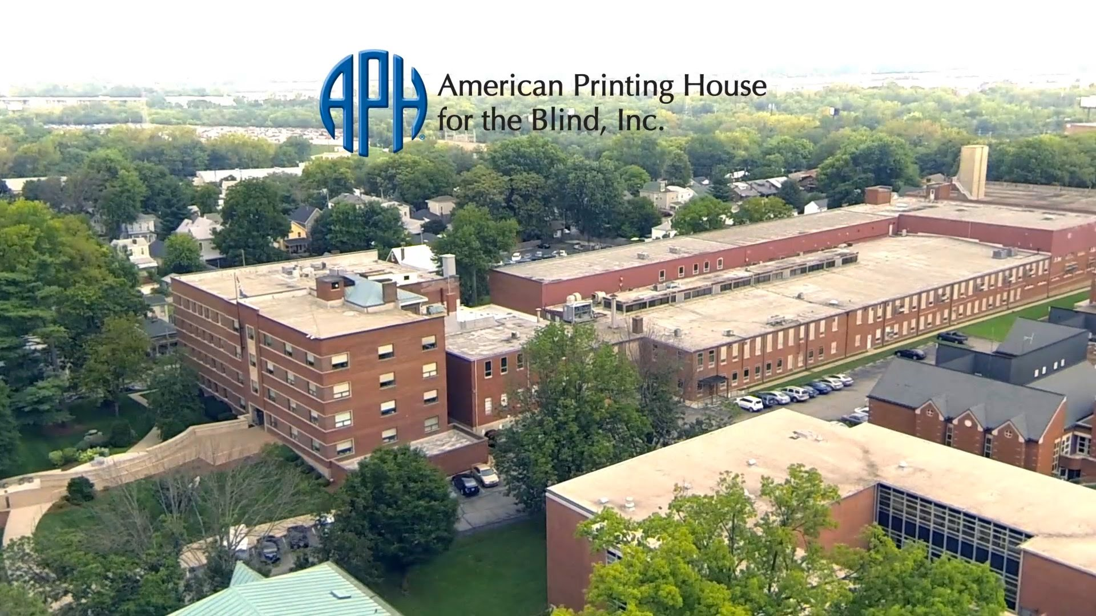
American Printing House for the Blind
“Empowering people who are blind or visually impaired by providing accessible and innovative products, materials and services for lifelong success. We believe the future belongs to everyone.” – APH Mission Statement
Notes:
I am a former employee of the American Printing House for the Blind where I worked as internal technical support handling network administration, desktop support, and more. This is where my understanding of Accessibility was strengthened.
The American Printing House for the Blind (APH) is the world’s largest nonprofit organization creating educational, workplace, and independent living products and services for people who are visually impaired.
APH received a federal mandate in 1879 when the Congress of the United States passed the Act to Promote the Education of the Blind. This act designates APH as the official supplier of educational materials to all students in the U.S. who meet the definition of blindness and are working at less than college level.
APH does produce many printed products including tests, textbooks, and regular books in braille and large print. We also produce recorded versions and computer file versions done in regular text or braille.

Slide 6
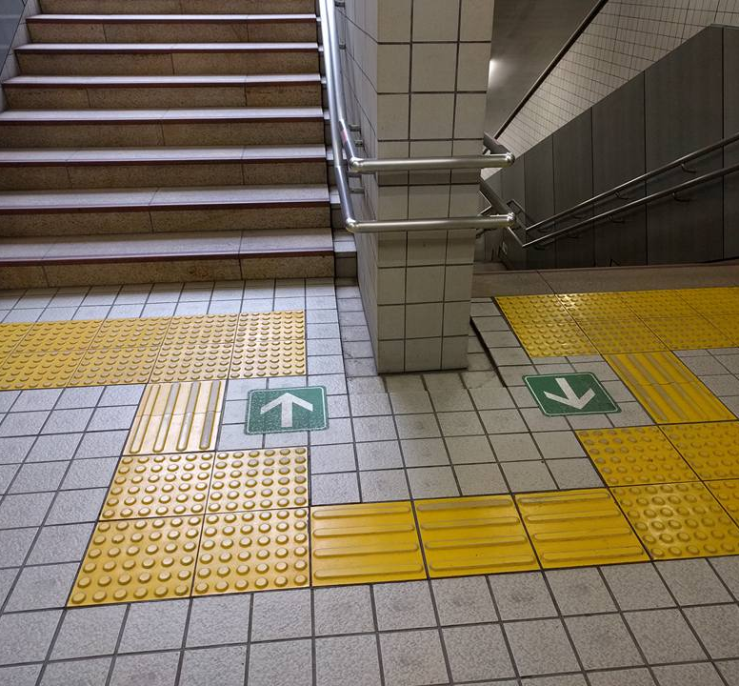
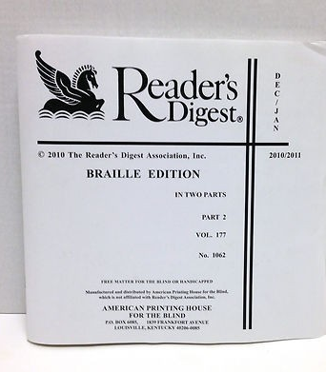
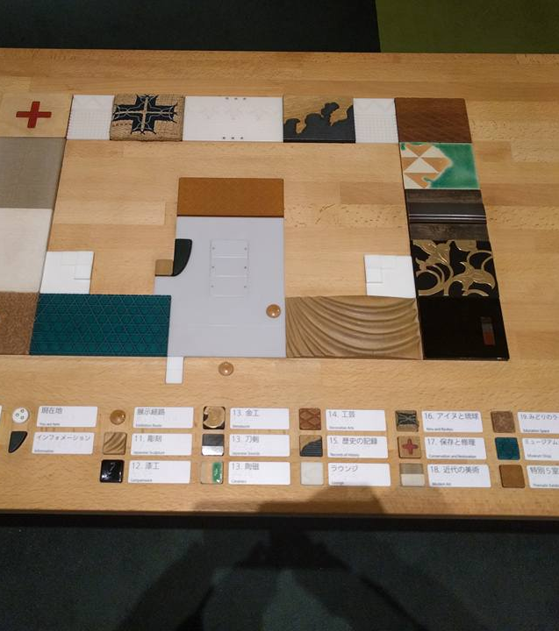
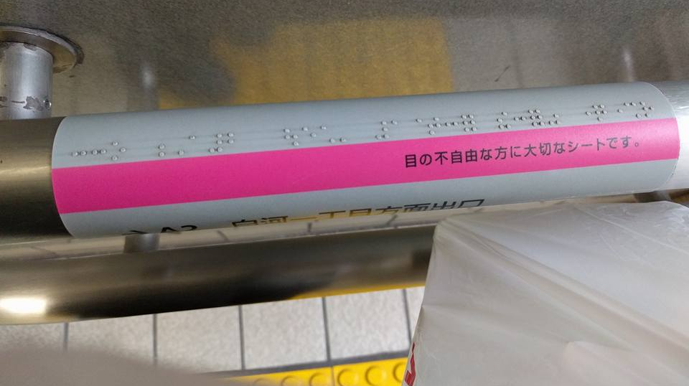
What is Accessibility and Disability?
Notes:
Disability can be thought of as a mismatch between an individual’s ability and the environment they are interacting with.
Accessibility is how well and equally can someone access something regardless of their physical and/or cognitive capabilities.
By making things accessible, we can help to:
Ensure everyone has equal access to the resources they need to work, learn, and experience life
Ensure equal access to information
Allow people to have independence in daily activities

Slide 7
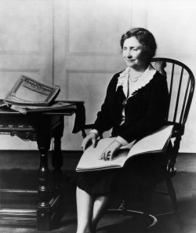
Why is Accessibility Important?
Notes:
“To people without sight The Reader’s Digest is like a wonderful friend who fills their hands with the treasures of instructive talk and world-wide news. For a few days each month, I am surrounded by…the full, surging life of the world.” —Helen Keller
Accessibility allows people to be active participants in society instead of just wall flowers.
Accessibility opens the world to all, and in doing so it helps to make the world better for everyone. Equal access to information and life experiences, allows everyone to have a better understanding of the world around them. It allows people to better relate to one another. It allows them to make more informed decisions that benefit themselves and the world around them. It allows them to be more independent. All this helps to increase the chances for healthier individuals and a healthier society.
The following post does a good job of highlighting the importance of Accessibility (further details after the link below):
https://www.linkedin.com/posts/alexanderhauerslevjensen_tech4good-a11y-accessibility-activity-6563069172622868480-yjKP
In the above linked post, the user described how they were able to use an app for those with visual accessibility needs to visit the grave of his father on his own.
Example of issues one might experience with filling out inaccessible forms: https://youtu.be/-O5b529V96g?t=1593
Bullet points I previously had on this slide:
Helps everyone
Informed decisions
Healthier individuals
Healthier society
Independent living
The COVID pandemic severely emphasized the real human cost of not paying attention to accessibility. Individuals with various physical and cognitive disabilities were almost 6 times more likely to die from COVID than others once admitted to a hospital. They were less likely to be properly informed about how to protect themselves, get treatment, recognize the severity of their symptoms, aid in their own care, etc. Information was regularly conveyed in ways that left them out of the loop.
This is part of why such a big deal was made when Governor Beshear of Kentucky made sure to have a sign language interpreter every time he did one of his COVID updates. It is also a part of the reason behind the Biden administrations push to improve Accessibility of various government briefings, applications, and websites.
Sources for this slide:
After old age, intellectual disability is greatest risk factor for death from COVID-19, study finds – ScienceDaily
6 out of 10 people who have died from COVID-19 are disabled | The Health Foundation
Deadly Discrimination: The Forgotten Impact Of Covid-19 On People With Disabilities (forbes.com)
COVID-19 Infections, Deaths Higher Among Those With Intellectual Disabilities : NPR
Coronavirus: Kentucky Gov. Beshear learns sign language during updates (cincinnati.com)
Gov. Beshear's silent partners prepare to exit spotlight as regular coronavirus briefings end | News | wdrb.com

Slide 8






Categories of Accessibility
Visual
Hearing
Mobility
Comprehension
Technological Access
State of Urgency

Slide 9
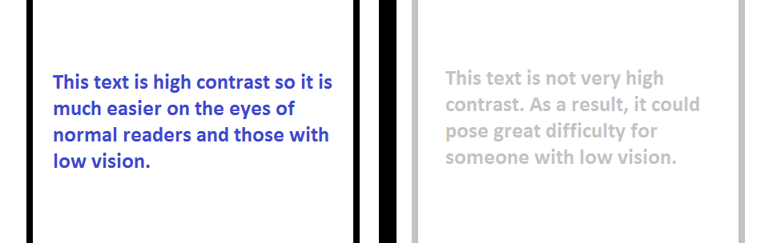
Visual
Notes:
Legally Blind is a level of vision loss that has been legally defined to determine eligibility for benefits. In the United States, this refers to a medically diagnosed central visual acuity of 20/200 or less in the better eye with the best possible correction, and/or a visual field of 20 degrees or less.
Random tags placed by some WYSIWYG interfaces, and CSS tags that don’t make sense. (i.e. SharePoint)
Lack of alt text or other code that helps makes object identifiable.
Unclear descriptions when things are read out.
Things that hurt visual Accessibility include:
Lack of alt text on images
Bad style formatting in code
Poor navigation
Poor wording
Poor contrast
No audio indication

Slide 10
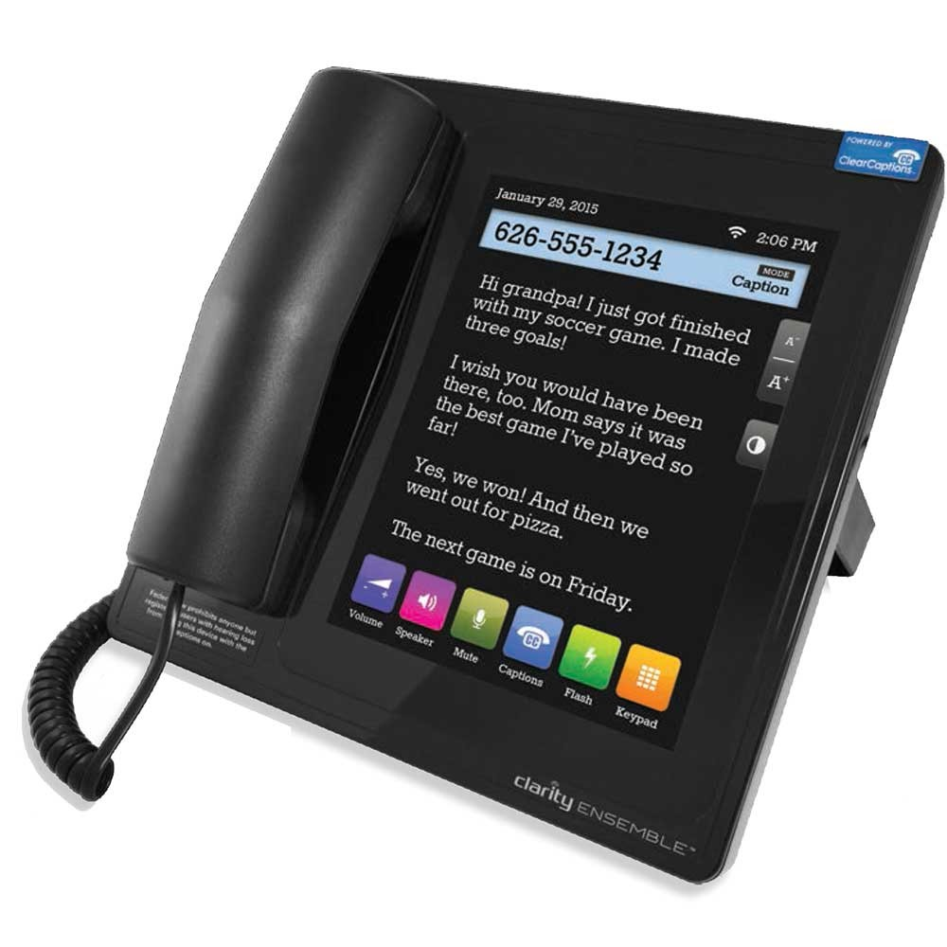
Hearing
Notes:
Things that can hurt hearing accessibility:
Lack of visual indicators
No subtitles
Muffled audio
Multiple videos with sound auto playing

Slide 11
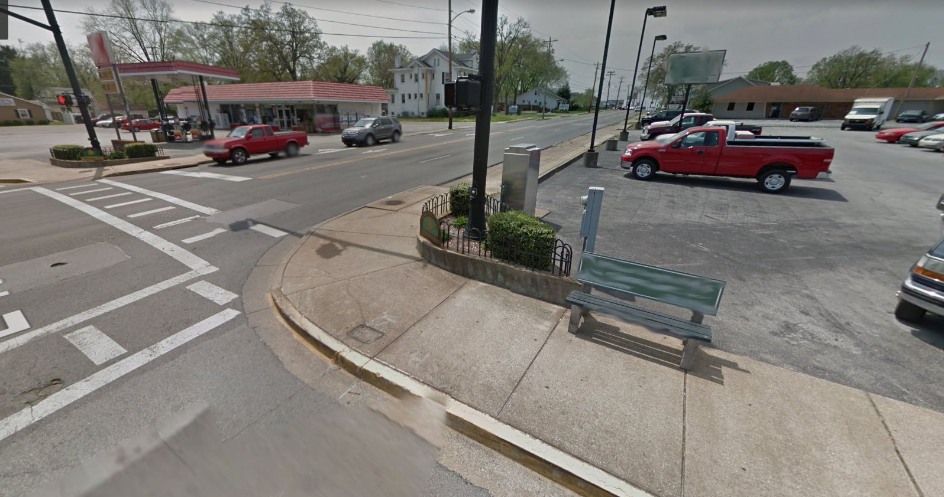
Mobility
Notes:
Mobility issues can involve an inability of some elements to be accessed through simple keyboard shortcuts like tab, space bar, or enter. It can also be more physical mobility barriers like hard to access cross walk buttons, poorly marked cross walks, or no ramp or stair options.
Things that can help with mobility accessibility:
Limit number of steps
Basic navigation keys
Keyboard shortcuts
Good physical design

Slide 12
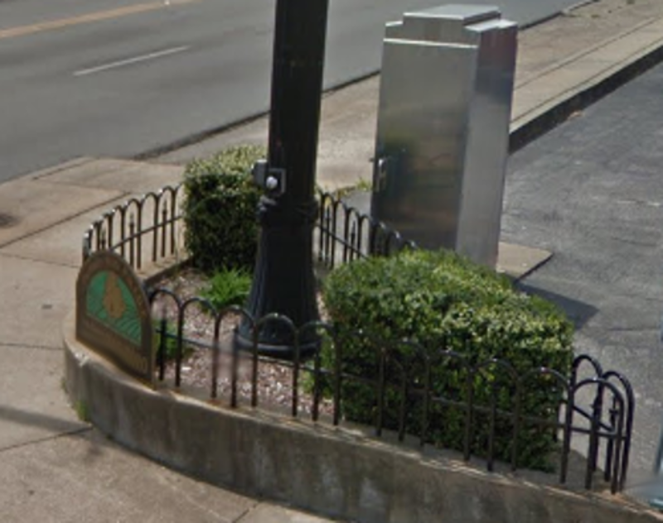
Notes:
The picture on this slide depicts a crosswalk in my old hometown of Bowling Green, KY

Slide 13
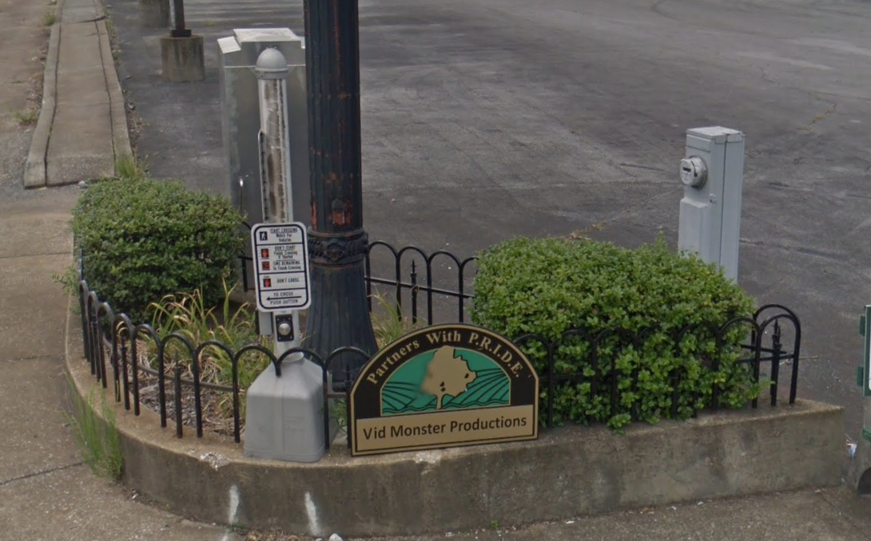
Notes:
The inaccessible pictures were from around 2015/2016, and it had been that way since sometime before 2011. Sometime during 2017 / 2018 it was finally updated to be accessible.

Slide 14
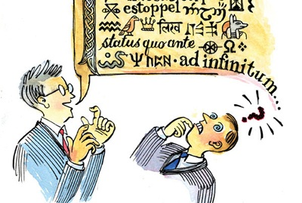
Comprehension
Notes:
Things that can help with comprehension:
Use clear, concise language
Consider your audience
Provide informative resources
Consider what grade level similar resources are written in
Included translations

Slide 15
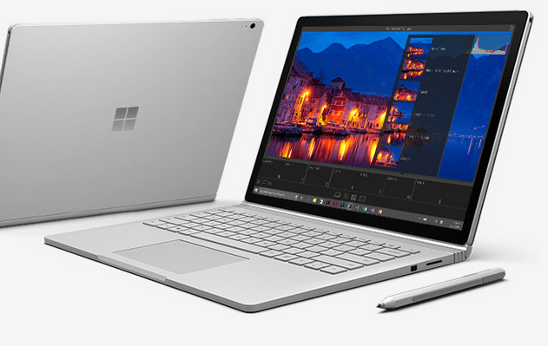
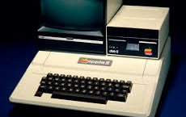
Technological Access
Notes:
Apple 2 Image sourced from the Smithsonian History Explorer. Website located at: https://historyexplorer.si.edu/resource/apple-ii-personal-computer. Microsoft Surface Book 3 image came from a Microsoft.com page.
Things that can impact Technological accessibility:
Internet access quality
Computer technology access
Printer access
Access to advanced accessible technology
Basically technological access deeply impacts how someone accesses and interacts with content.

Slide 16

State of Urgency

Slide 17
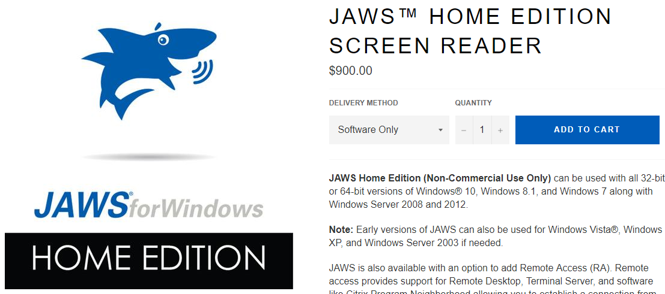
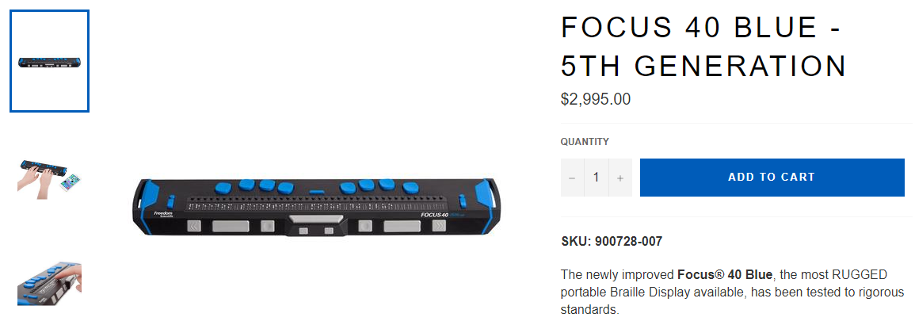
Common Issues
Notes:
Cost prohibitive?
I spent around $1100 for my gaming desktop when I built it. If I upgrade the video card I am looking at spending another $500.
Imagine spending that kind of dough but only getting a basic computer for word processing and internet surfing.

Slide 18
Who is responsible for Accessibility?
Everyone

Slide 19

What can I do?
Notes:
Keep accessibility in mind from the start. Like with any problem, it is easier long-term to be proactive rather than reactive.
This also means testing early and often, and include users with Accessibility needs when possible.
Make use of the many tools already installed on your computer. I.e. Magnifier, VoiceOver, narrator, color filters.
Windows Specific Tools:
Narrator is the built in screen reader in Windows though it is recommended that you also use a second one like NVDA or JAWS since, preferably both of those, since different screen readers operate differently and most users will make use of NVDA or JAWS.
Microsoft recently added a bunch of options under the Ease of Access settings that developers can use to test. Some newer options include:
color filter options
Braille display support options
Microsoft Office programs almost all have a “Check Accessibility” tool, which can typically be found under a “Review” tab. This is available in O365, Office for Mac and Office for Windows.
There are also a bunch of applications available that can be used with Windows and other platforms as supported:
NVDA or Non-Visual Desktop Access, a free, open-source screen reader. (Windows)
Color Contrast Checker by the Paciello Group (Windows/OSX)
Available at the following url: https://www.tpgi.com/color-contrast-checker/
Accessibility Insights is an open-source tool, maintained by Microsoft, and available for multiple platforms and even as an automated pipeline tool.
Available at the following url: https://accessibilityinsights.io/
Desktop tool available for Windows and Linux.
Browser tool available for Edge and Chrome.
Mobile app available for Android.
MAC has its own built in screen reader called VoiceOver and a magnifier app named Zoom.
Learn how to turn on and use Zoom and VoiceOver by going to the following url: https://www.apple.com/accessibility/vision/
The Social Security Administration maintains the browser tool, Accessible Name and Description Inspector (ANDI).

Slide 20
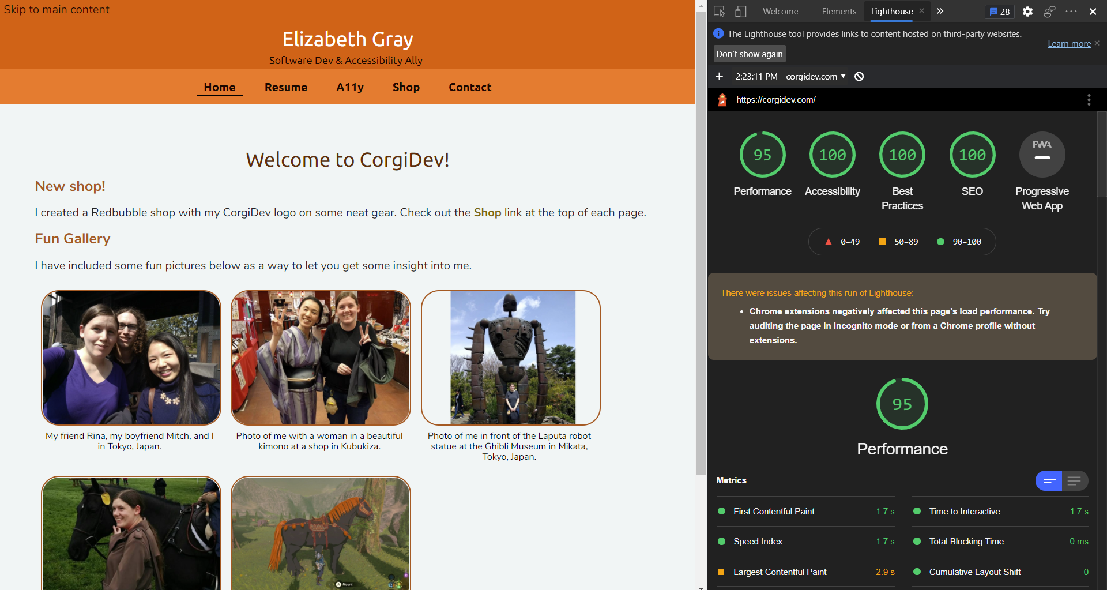
Browser Dev Tools
Notes:
All browsers have dev tools and almost all have some form of Accessibility tests built in. Many of these are powered by Axe created by Deque or Lighthouse, the open-source tools created by Google.

Slide 21
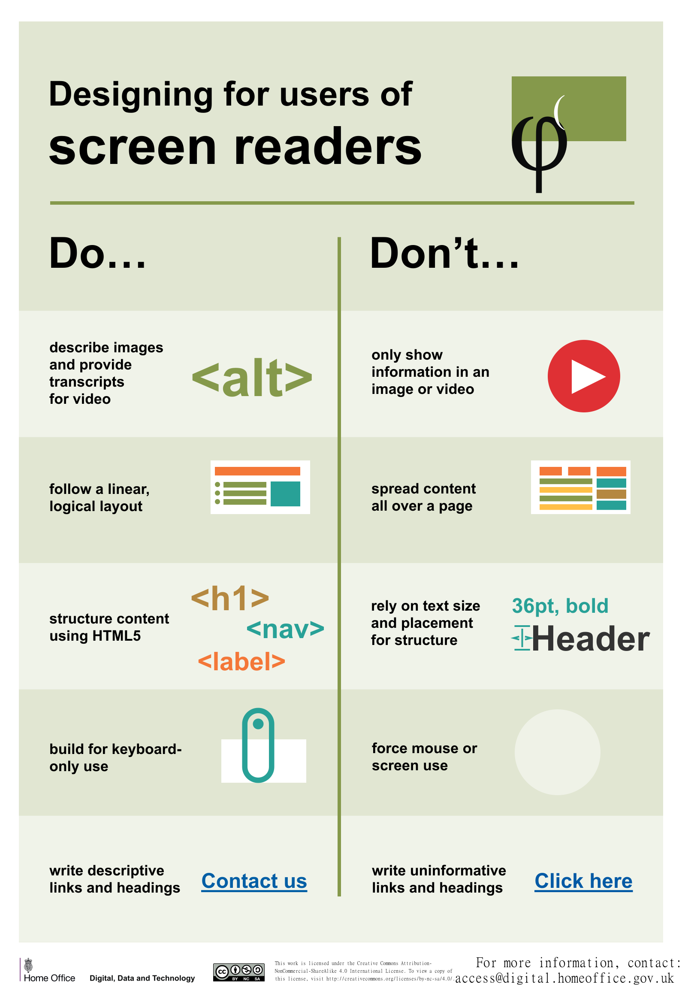
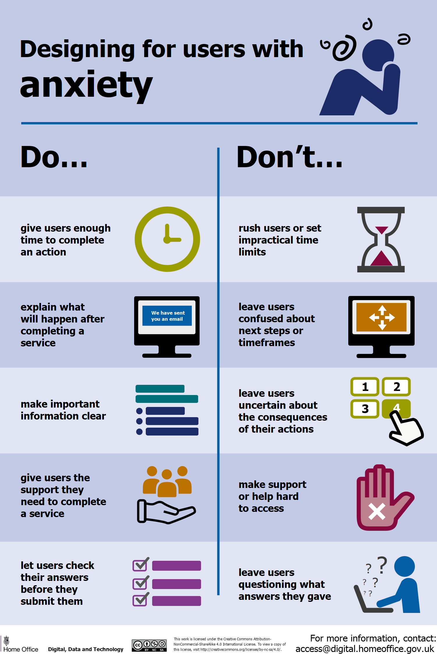
Notes:
UK Home Office Digital, Data and Technology Profession - https://www.gov.uk/government/organisations/digital-data-and-technology-profession
UK Home Office Accessibility Posters on GitHub - https://github.com/UKHomeOffice/posters/tree/master/accessibility

Slide 22

Thank You!
Twitter: @TheCorgiDev
Email: egray@corgidev.com
Website: https://corgidev.com

Slide 23
Resource Websites Additional Links in slide notes
“Selfish Accessibility” by Adrian Roselli on Youtube
https://www.youtube.com/watch?time_continue=185&v=-O5b529V96g
WCAG 2.1 Standards
https://www.w3.org/TR/WCAG21/
UEB Online – Free Online Accessible Braille training for anyone
https://uebonline.org
https://www.nvaccess.org/
http://wave.webaim.org/
https://www.w3.org/wiki/Accessibility_testing
NVDA Screen Reader Home
WebAim Accessibility Testing Tools and Information
W3C Accessibility Testing Article
UK Government Accessibility in Government Blog
https://accessibility.blog.gov.uk/2016/09/02/dos-and-donts-on-designing-for-accessibility/
Accessibility Technology & Tools | Microsoft Accessibility
https://www.microsoft.com/en-us/accessibility
Create accessible Office documents | Microsoft Support
https://support.microsoft.com/en-us/topic/create-accessible-office-documents-868ecfcd-4f00-4224-b881-a65537a7c155
Notes:
Contrast Checker: https://contrastchecker.com/
This website allows you to compare a foreground and background color to see how well they would contrast.
UK Government Posters repository: https://github.com/UKHomeOffice/posters
Has a bunch of posters made by the UK government, including the Accessibility posters featured in one of the later slides.
Chrome Spectrum Addon: https://chrome.google.com/webstore/detail/spectrum/ofclemegkcmilinpcimpjkfhjfgmhieb?hl=en
This addon allows you to view any website in the way someone with various forms of color blindness would view it.
Section 508 Compliance Official Page: https://www.section508.gov/

Slide 24
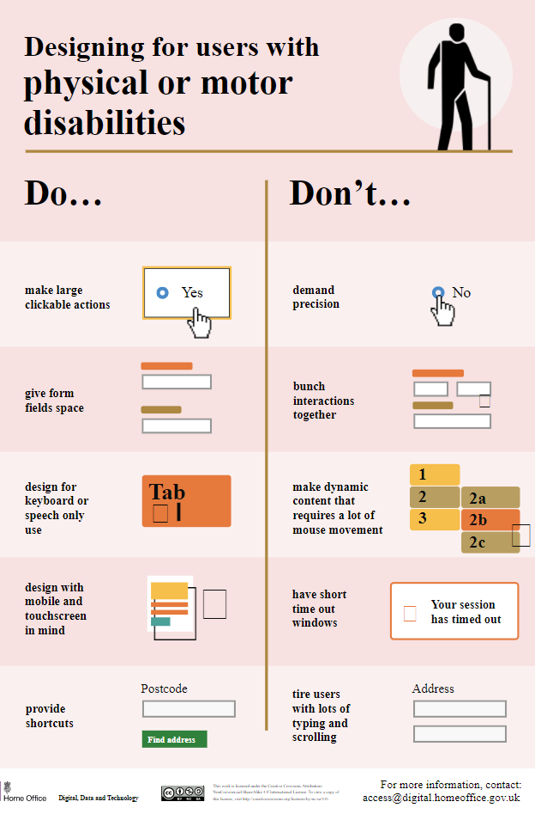
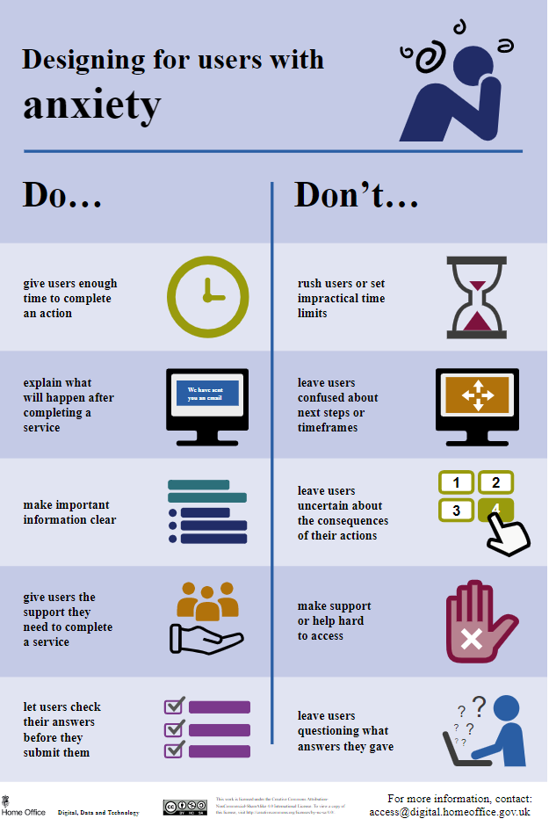
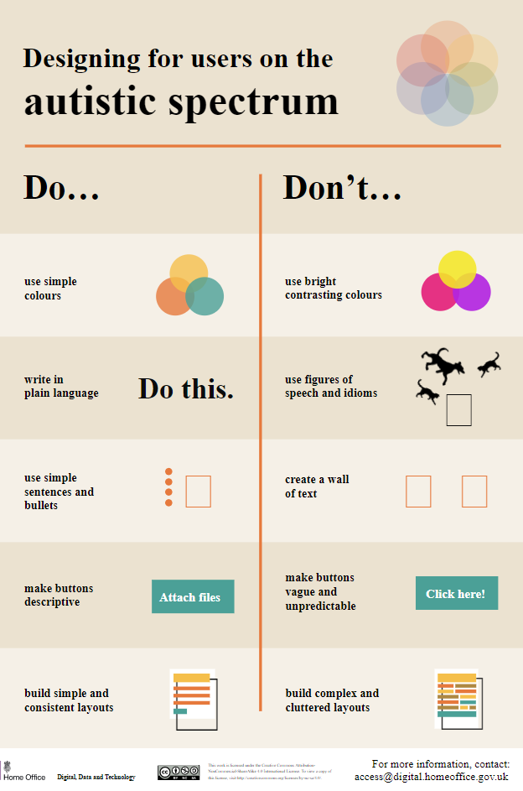
UK Home Office Accessibility Posters available on GitHub in svg, txt, and pdf format in the UK Home Office GitHub Poster repo.
Notes:
UK Home Office Digital, Data and Technology Profession - https://www.gov.uk/government/organisations/digital-data-and-technology-profession
UK Home Office Accessibility Posters on GitHub - https://github.com/UKHomeOffice/posters/tree/master/accessibility

Slide 25
Cool Technology
The next 4 slides feature some information about technologies available to help improve the accessibility of programming, transportation, and navigating everyday life. The include:
Be My Eyes Application
Accessible Cities Initiative
Diagram of a Building set up with beacons for Accessible Cities Initiative.
Code Jumper
Microsoft Adaptive Controller

Slide 26
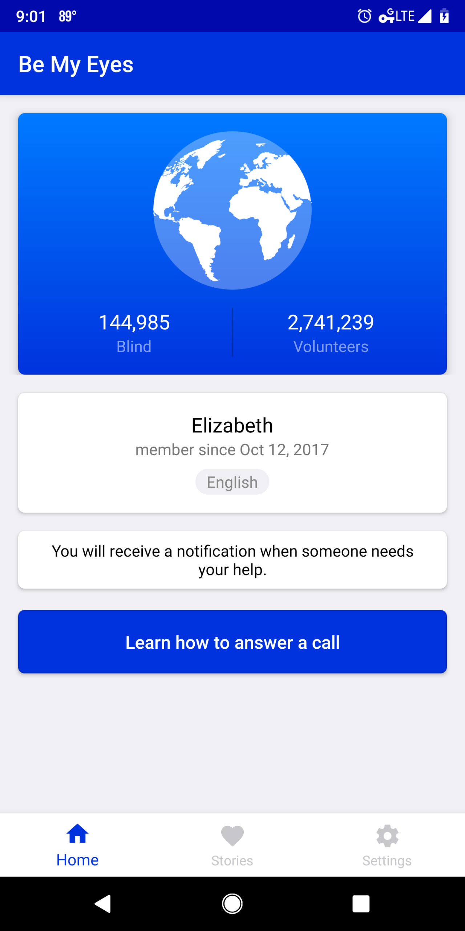
Be My Eyes
Notes:
Free app
Available on iOS and Android devices
Connects individuals with visual accessibility needs with volunteers who can assist them.
Over 2 million volunteers
Microsoft uses it!

Slide 27
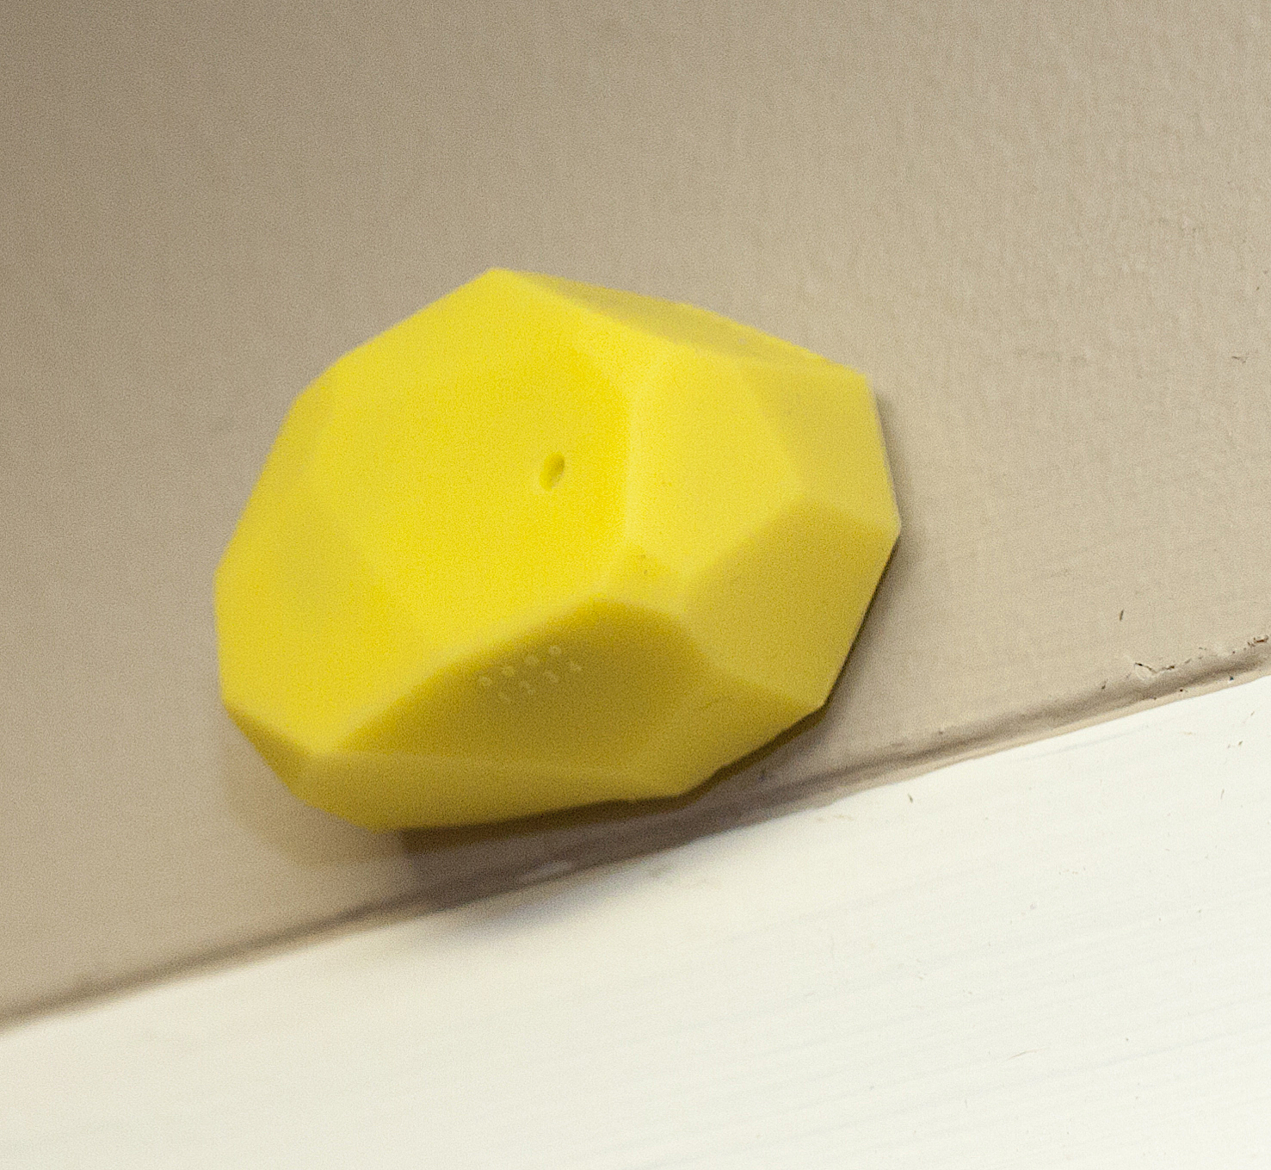
Accessible Cities Initiative
Notes:
http://www.aph.org/nearby-explorer/
https://www.youtube.com/watch?v=zbxJHkFxPZc&index=4&list=PLUj6DcM1nN3Hu4j11RpBnOk30fhGKov4l
APH received a grant from the city of Louisville.
APH is working to make cities more accessible.
Uses beacons placed throughout buildings combined with an app on your mobile device.
Has already been set up in multiple locations.

Slide 28
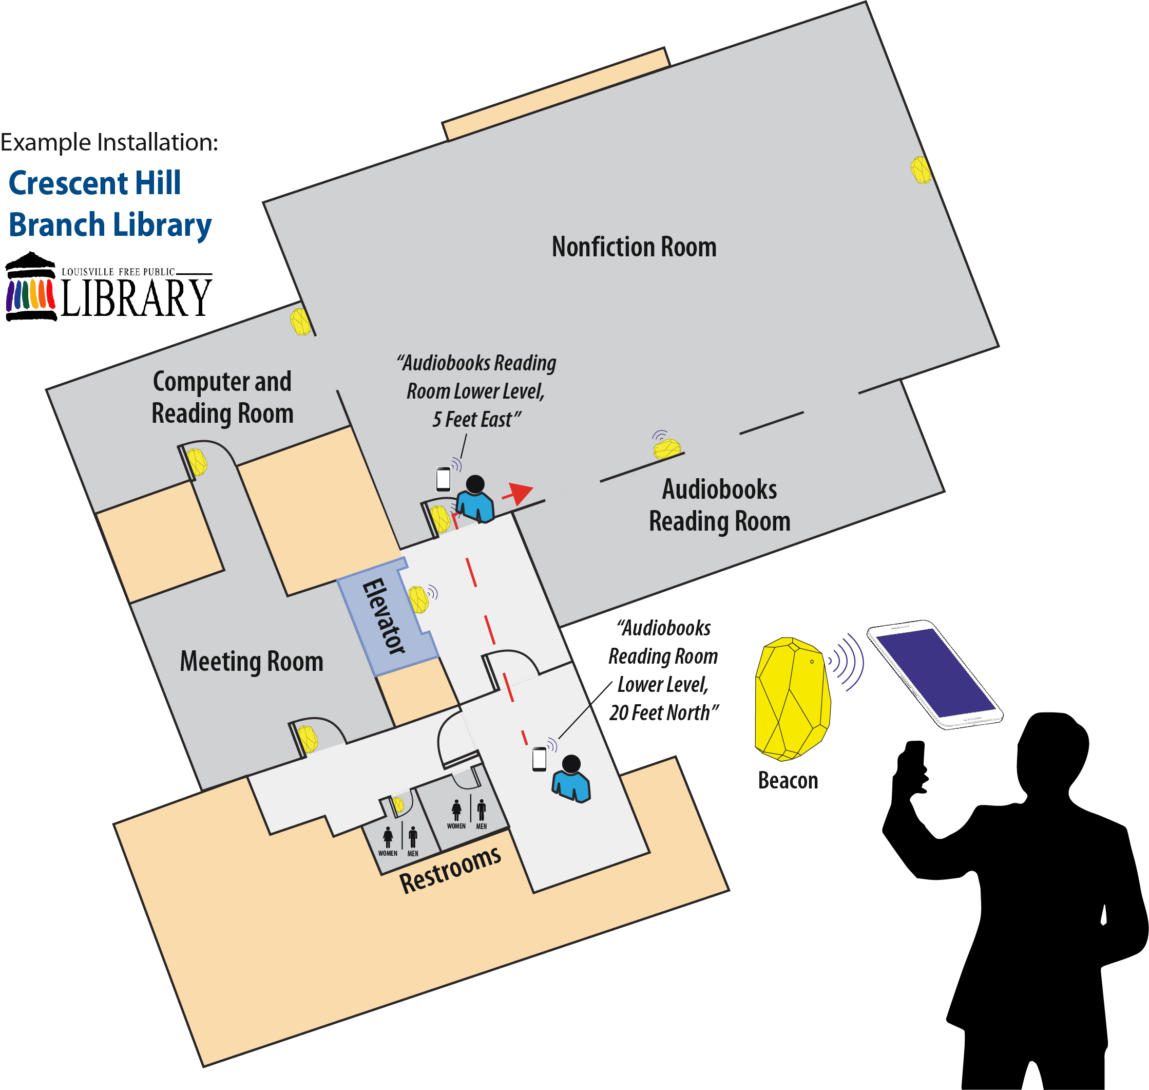

Slide 29
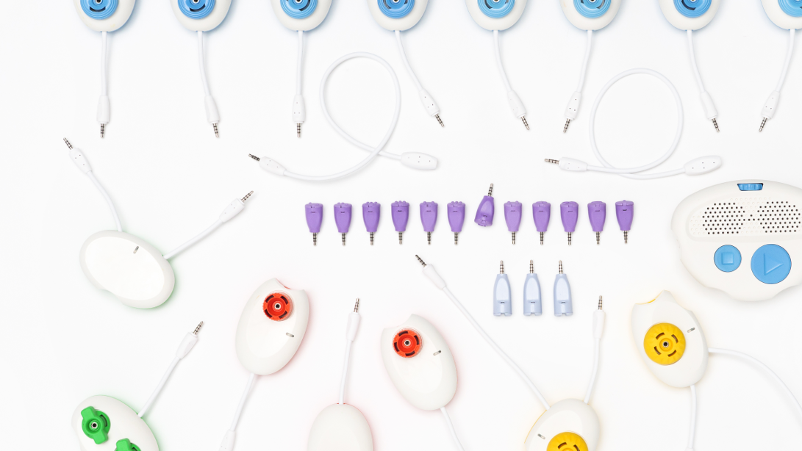
Code Jumper
Notes:
Information on Code Jumper can be found at: https://codejumper.com/
Code Jumper was developed by Microsoft and is distributed by the American Printing House for the Blind.
Teaches students about programming using tactile buttons, knobs, and more that they can easily interact with.

Slide 30
Microsoft Adaptive COntroller
Notes:
Microsoft Adaptive Controller and attachments can be found at https://www.xbox.com/en-US/xbox-one/accessories/controllers/xbox-adaptive-controller.

